Slide 1
Number system, Operations and Basic Logic Gates
Part 3
Course : CPEN6265010 Digital System
Effective Period : September 2025

Slide 2
Related LO
Learning Objectives
LO1: Analyze and Design Combinational Logic Circuits.

Slide 3
Outlines
The Inverter
The AND Gate
The OR Gate
The NAND Gate
The NOR Gate
The Exclusive-OR and Exclusive-NOR Gates
Fixed-Function Logic Gates

Slide 4
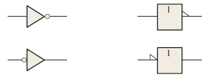
The Inverter
The inverter performs the Boolean NOT operation. When the input is LOW, the output is HIGH; when the input is HIGH, the output is LOW.
LOW (0) HIGH (1)
HIGH (1) LOW(0)
The NOT operation (complement) is shown with an overbar. Thus, the Boolean expression for an inverter is X = A.

Slide 5
The Inverter
A
X
Example waveforms:
A
X
A group of inverters can be used to form the 1’s complement of a binary number:
Binary number
1 0 0 0 1 1 0 1
0 1 1 1 0 0 1 0
1’s complement

Slide 6
The AND Gate
A
X
A
X
B
B
The AND gate produces a HIGH output when all inputs are HIGH; otherwise, the output is LOW. For a 2-input gate, the truth table is
0 0
0 1
1 0
1 1
0
0
0
1
The AND operation is usually shown with a dot between the variables but it may be implied (no dot). Thus, the AND operation is written as X = A .B or X = AB.

Slide 7
The AND Gate
A
A
X
X
B
B
Example waveforms:
A
B
X
The AND operation is used in computer programming as a selective mask. If you want to retain certain bits of a binary number but reset the other bits to 0, you could set a mask with 1’s in the position of the retained bits.

Slide 8
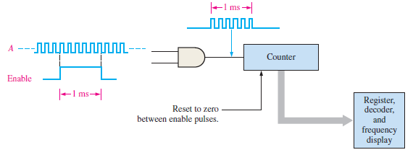
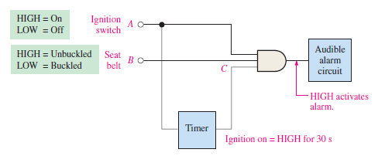
The AND Gate
An AND gate performing an enable/inhibit function for a frequency counter.
A simple seat belt alarm circuit using an AND gate.

Slide 9
The OR Gate
A
X
A
X
B
B
The OR gate produces a HIGH output if any input is HIGH; if all inputs are LOW, the output is LOW. For a 2-input gate, the truth table is
0 0
0 1
1 0
1 1
0
1
1
1
The OR operation is shown with a plus sign (+) between the variables. Thus, the OR operation is written as X = A + B.

Slide 10
The OR Gate
A
X
A
X
B
B
Example waveforms:
A
B
X
The OR operation can be used in computer programming to set certain bits of a binary number to 1.
Example
ASCII letters have a 1 in the bit 5 position for lower case letters and a 0 in this position for capitals. (Bit positions are numbered from right to left starting with 0.) What will be the result if you OR an ASCII letter with the 8-bit mask 00100000?
Solution
The resulting letter will be lower case.

Slide 11
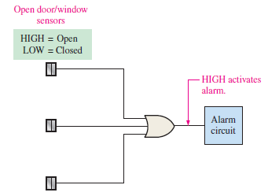
The OR Gate
A simplified portion of an intrusion detection and alarm system can be build using OR. This system could be used for one room in a home—a room with two windows and a door. The sensors are magnetic switches that produce a HIGH output when open and a LOW output when closed. As long as the windows and the door are secured, the switches are closed and all three of the OR gate inputs are LOW. When one of the windows or the door is opened, a HIGH is produced on that input to the OR gate and the gate output goes HIGH. It then activates and latches an alarm circuit to warn of the intrusion.
A simplified intrusion detection system using an OR gate.

Slide 12
The NAND Gate
A
X
A
X
B
B
The NAND gate produces a LOW output when all inputs are HIGH; otherwise, the output is HIGH. For a 2-input gate, the truth table is
0 0
0 1
1 0
1 1
1
1
1
0
The NAND operation is shown with a dot between the variables and an overbar covering them. Thus, the NAND operation is written as X = A .B (Alternatively, X = AB.)

Slide 13
The NAND Gate
A
X
A
X
B
B
Example waveforms:
A
B
X
The NAND gate is particularly useful because it is a “universal” gate – all other basic gates can be constructed from NAND gates.
Question
How would you connect a 2-input NAND gate to form a basic inverter?

Slide 14
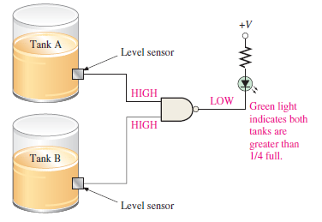
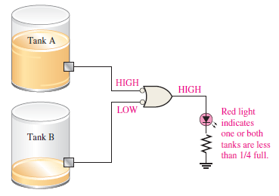
The NAND Gate
Two tanks store certain liquid chemicals that are required in a manufacturing process. Each tank has a sensor that detects when the chemical level drops to 25% of full.
The sensors produce a HIGH level of 5 V when the tanks are more than one-quarter full. When the volume of chemical in a tank drops to one-quarter full, the sensor puts out a LOW level of 0 V.
It is required that a single green light-emitting diode (LED) on an indicator panel show when both tanks are more than one-quarter full. Show how a NAND gate can be used to implement this function.

Slide 15
The NOR Gate
A
X
A
X
B
B
The NOR gate produces a LOW output if any input is HIGH; if all inputs are HIGH, the output is LOW. For a 2-input gate, the truth table is
0 0
0 1
1 0
1 1
1
0
0
0
The NOR operation is shown with a plus sign (+) between the variables and an overbar covering them. Thus, the NOR operation is written as X = A + B.

Slide 16
The NOR Gate
A
X
A
X
B
B
Example waveforms:
A
B
X
The NOR operation will produce a LOW if any input is HIGH.
Example
When is the LED is ON for the circuit shown?
Solution
The LED will be on when any of the four inputs are HIGH.

Slide 17
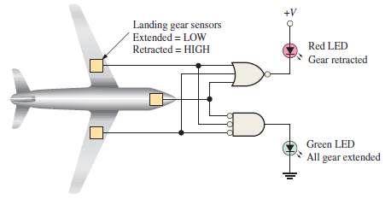
The NOR Gate
As part of an aircraft’s functional monitoring system, a circuit is required to indicate the status of the landing gears prior to landing. A green LED display turns on if all 3 gears are properly extended when the “gear down” switch has been activated in preparation for landing. A red LED display turns on if any of the gears fail to extend properly prior to landing. When a landing gear is extended, its sensor produces a LOW voltage. When a landing gear is retracted, its sensor produces a HIGH voltage. Implement a circuit to meet this requirement.

Slide 18
The Exclusive-OR and Exclusive-NOR Gates
A
X
A
X
B
B
The XOR gate produces a HIGH output only when both inputs are at opposite logic levels. The truth table is
0 0
0 1
1 0
1 1
0
1
1
0
The XOR operation is written as X = AB + AB. Alternatively, it can be written with a circled plus sign between the variables as X = A + B.

Slide 19
The Exclusive-OR and Exclusive-NOR Gates
A
X
A
X
B
B
Example waveforms:
A
B
X
Notice that the XOR gate will produce a HIGH only when exactly one input is HIGH.
Question
If the A and B waveforms are both inverted for the above waveforms, how is the output affected?
There is no change in the output.

Slide 20

The Exclusive-OR and Exclusive-NOR Gates
A certain system contains 2 identical circuits operating in parallel. As long as both are operating properly, the outputs of both circuits are always the same. If one of the circuits fails, the output will be at opposite levels at some time. Devise a way to monitor and detect that a failure has occurred in one of the circuits.

Slide 21
The Exclusive-OR and Exclusive-NOR Gates
A
X
A
X
B
B
The XNOR gate produces a HIGH output only when both inputs are at the same logic level. The truth table is
0 0
0 1
1 0
1 1
1
0
0
1
The XNOR operation shown as X = AB + AB. Alternatively, the XNOR operation can be shown with a circled dot between the variables. Thus, it can be shown as X = A . B.

Slide 22
The Exclusive-OR and Exclusive-NOR Gates
A
X
A
X
B
B
Example waveforms:
A
B
X
Notice that the XNOR gate will produce a HIGH when both inputs are the same. This makes it useful for comparison functions.
Question
If the A waveform is inverted but B remains the same, how is the output affected?
The output will be inverted.

Slide 23
Fixed Function Logic
Two major fixed function logic families are TTL and CMOS. A third technology is BiCMOS, which combines the first two. Packaging for fixed function logic is shown.
DIP package SOIC package

Slide 24
Fixed Function Logic
Some common gate configurations are shown.

Slide 25
Fixed Function Logic
Logic symbols show the gates and associated pin numbers.

Slide 26
Fixed Function Logic
Data sheets include limits and conditions set by the manufacturer as well as DC and AC characteristics. For example, some maximum ratings for a 74HC00A are:

Slide 27
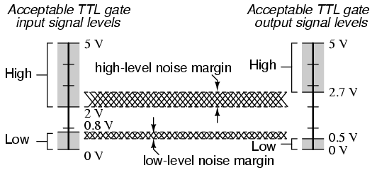
Fixed Function Logic
Bipolar a.k.a. TTL (Transistor-Transistor Logic)
CMOS (Complementary Metal-Oxide Semiconductor)

Slide 28
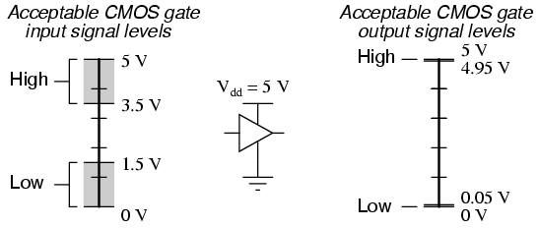
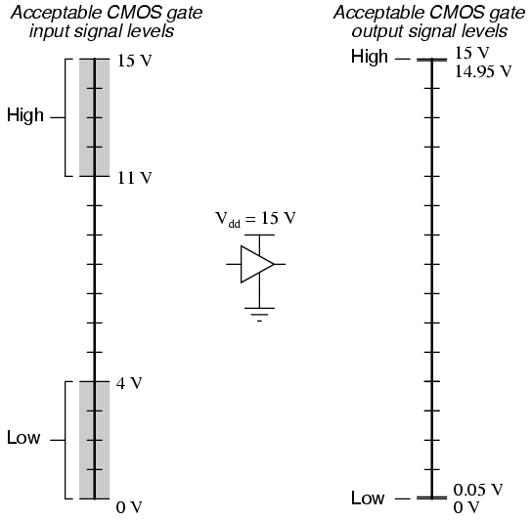
Fixed Function Logic

Slide 29
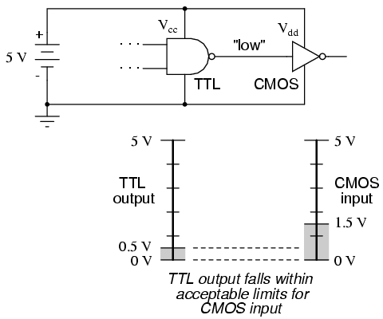
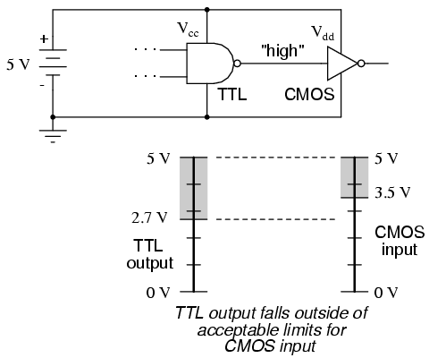
Fixed Function Logic

Slide 30
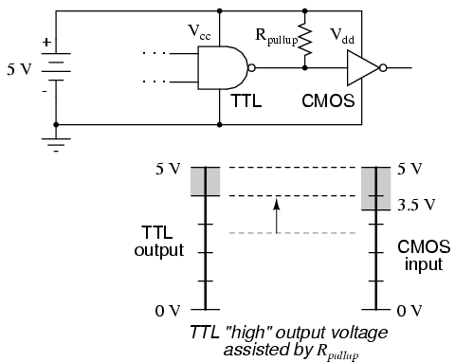
Fixed Function Logic

Slide 31
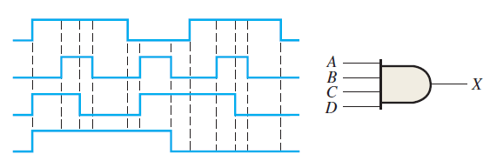
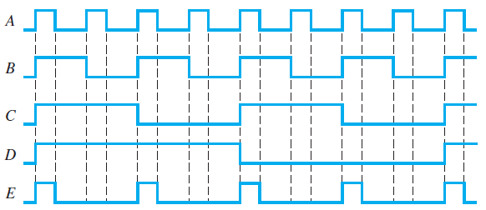
Exercise
The input waveforms applied to a 4-input AND gate are as indicated below. The output of the AND gate is fed to an inverter. Draw the net output waveform of this system.
For the waveforms given, A and B are ANDed with output F, D and E are ANDed with output G, and C, F, and G are ORed. Draw the net output waveform.

Slide 32
Exercise
What is the weight of 7 in each of the following decimal numbers?
(a) 1947 (b) 1799 (c) 1979
Express each of the following decimal numbers as a power of ten:
(a) 1000 (b) 10000000 (c) 1000000000
Convert each decimal fraction to binary using the sum-of-weights method:
(a) 0.26 (b) 0.762 (c) 0.0975
How is zero represented in 2’s complement form?
Perform each addition in the 2’s complement form:
  (a) 00010110 + 00110011 (b) 01110000 + 10101111
Convert each binary number to hexadecimal:
(a) 1111 (b) 1011 (c) 11111
Convert each pair of decimal numbers to BCD, and add as indicated:
(a) 28 + 23 (b) 65 + 58 (c) 113 + 101

Slide 33
References
M. Morris Mano and Michael Ciletti. (2017). Digital Design: With an Introduction to the Verilog HDL, VHDL, and SystemVerilog 6th Edition. Pearson Education. New Jersey. ISBN: 9780134549897.
Thomas L. Floyd. (2014). Digital Fundamentals. 11. Prentice Hall. New Jersey. ISBN: 978-0132737968.
Number System tutorial: https://ryanstutorials.net/binary-tutorial/
Binary Numbers Explained – Beginners Guide: http://www.steves-internet-guide.com/binary-numbers-explained/

Slide 34
References
Null, Linda (2024). "The essentials of computer organization and architecture". 6th edition. Jones & Bartlett Learning, Burlington, Massachusetts. ISBN: 9781284259438..
Thomas L. Floyd. (2014). “Digital Fundamentals”. 11th Edition. Prentice Hall. New Jersey. ISBN: 978-0132737968.
Digital Logic Gates: https://www.electronics-tutorials.ws/logic/logic_1.html
CMOS and TTL Comparisons: https://circuitdigest.com/article/comparision-between-cmos-vs-ttl-logic-which-is-better-and-why

